Slide 1

SWOT Analysis of United Airlines Customer Service Tweets

Slide 2
Overview
Tweets from Feb 16-24
Competitors analyzed: American (US Airways), Delta, Southwest, Virgin America
SWOT provides framework for viewing ourselves in comparison with competitors
Notes:
We were tasked with performing market research on the perception of United Airlines in comparison to some of its competitors, and we decided to approach this problem by performing a sentiment analysis of Twitter data.
We used tweets from February 16th through 24th of this year, 2015.
American, Delta, Southwest, and United are the four largest airlines in the US. US Airways is a subsidiary of American Airlines which is in the process of being merged entirely.
Virgin America is included because it shares a major hub (SFO) with United.

Slide 3
Why Modelling
Understand the scale of:
Customer Service Events
Operational Concerns
Understand customer sentiments by region/location
Monitor trends
Notes:
While using modeling techniques is useful for the inferential analysis we’ve performed, we recommend deploying this model into production. Analyzing Twitter data, United could gain a high level understanding of company and industry trends. This model, and extensions of this model, could provide insight into the scale and distribution of customer service events and operational concerns. We could take a look at customer feedback by region, to understand how isolated or widespread events are, and by doing competitive analysis could contextualize this information. Over the long term, maintaining this model and collecting data will allow United to observe trends and respond to frequently-tweeted concerns in real time.

Slide 4
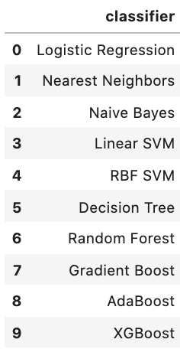
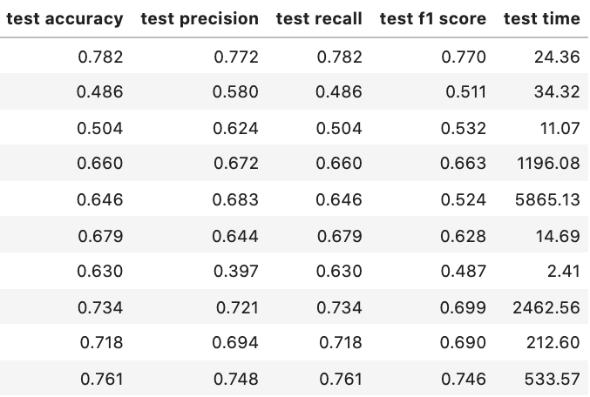
Modelling Results
Notes:
We built a model to classify tweets as positive, neutral or negative using NLP. We optimized this model for recall, because it is important to correctly identify all negative tweets, at the risk classifying a handful of tweets as negative even if they aren’t.
XGBoost and Logistic Regression models were close runners-up regarding predictive performance. If using this model for inference and continued computational demands are not a consideration then we recommend an XGBoost algorithm. Should this model be deployed into production, Logistic regression would be an excellent option as it takes 95% less computational time and though this particular run suffered from slight overfitting, optimizing regularization parameters and refining the natural language filters over the life of the model could dial back overfitting.

Slide 5
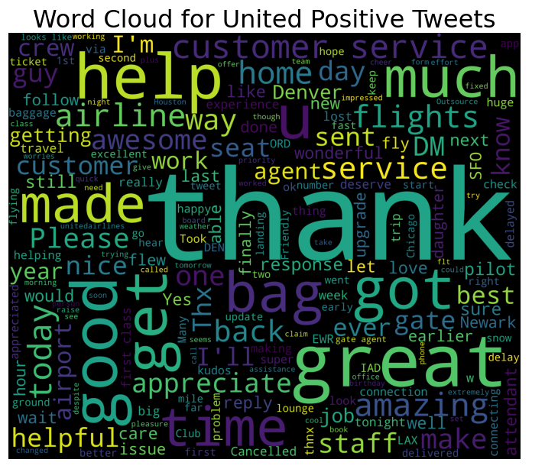
Strengths
Notes:
For our SWOT analysis, we generated word clouds from tweets in order to gauge what customers have to say about airline service.
From a United standpoint, our customers seem to have an overall good experience with our airline as you can see that there are a number of adjectives that are either thanking us or praising our service for being good.
*Next*

Slide 6
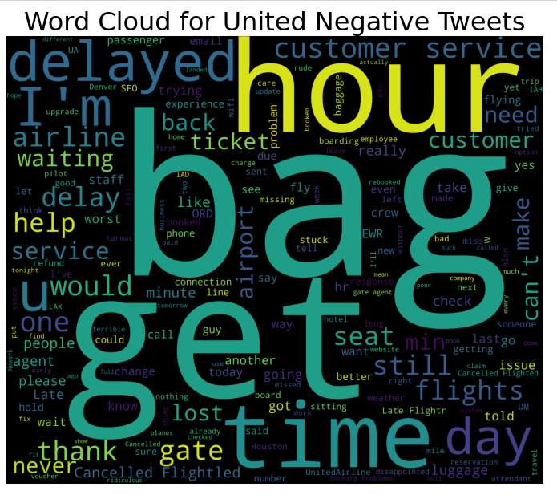
Weaknesses
Notes:
However, when you look at the word cloud generated from our negative tweets, you can see that the main concerns of our customers are with late flights or cancelled flights, with some concerns with baggage issues.
*Next*

Slide 7
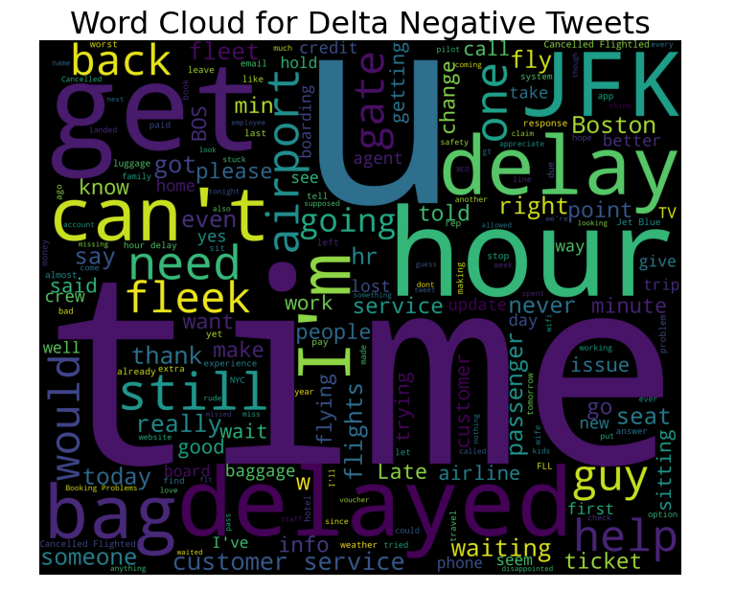
Opportunities
Notes:
When looking at the negative word clouds associated with our competitors, customer complaints about late or cancelled flights and baggage issues seems to be an industry-wide issue and not one that is unique to United.

Slide 8
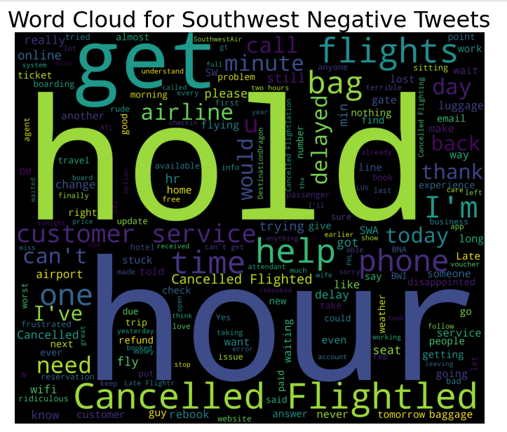
Opportunities
Notes:
Next - Pause

Slide 9
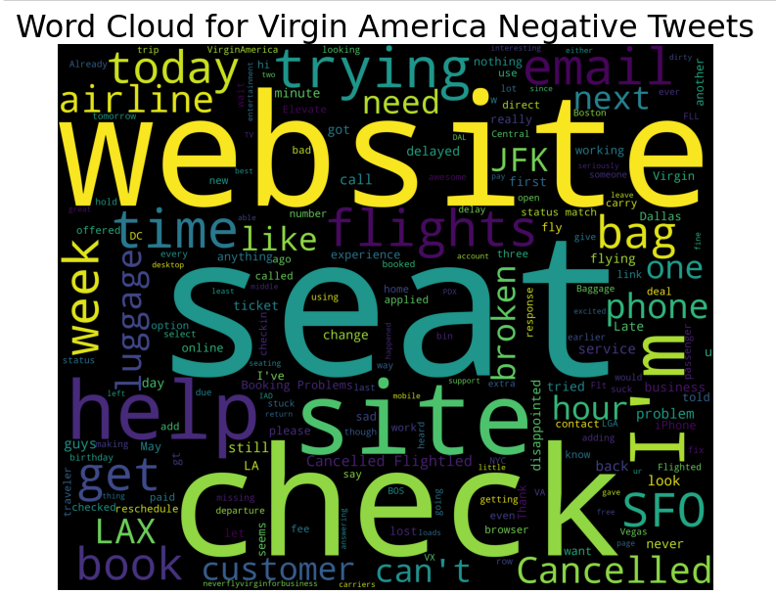
Opportunities
Notes:
Next - Pause

Slide 10
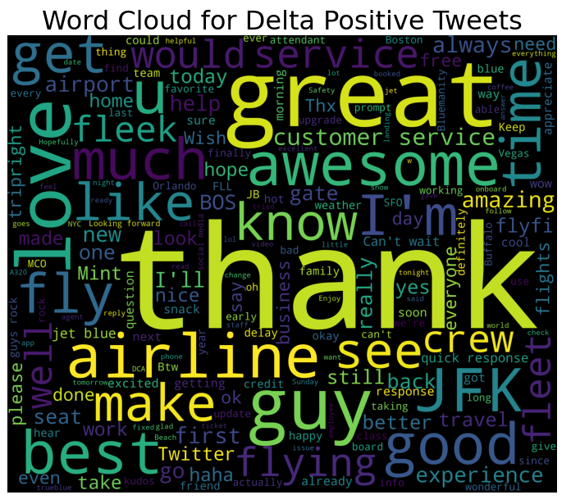
Threats
Notes:
What seems to set our competitors apart, though, is customer interaction and how they’re able to handle customer complaints about late/cancelled flights and baggage issues in a way that at least makes the customer feel as if their needs have been addressed.

Slide 11
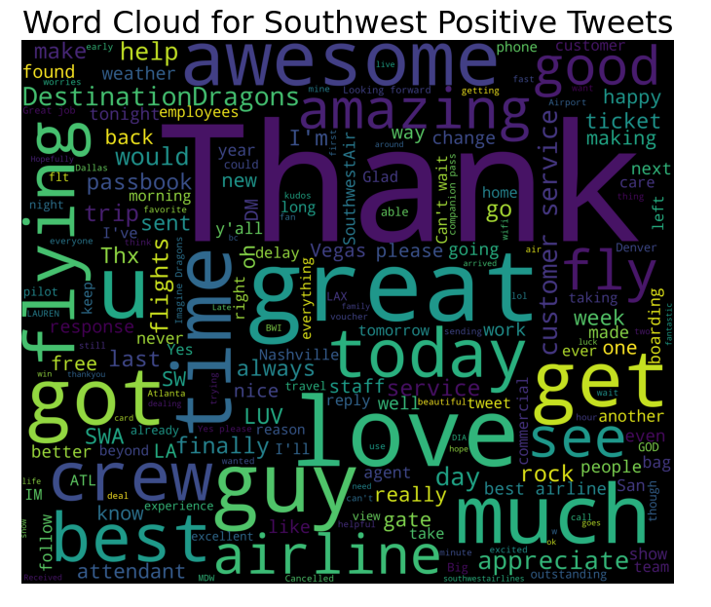
Threats
Notes:
And when you look at Southwest’s wordcloud, the tag “DestinationDragons” appears, which is a concert series with Imagine Dragons sponsored by Southwest.
It shows that some of our competitors have good interactions with their customers in a way that we might not.

Slide 12
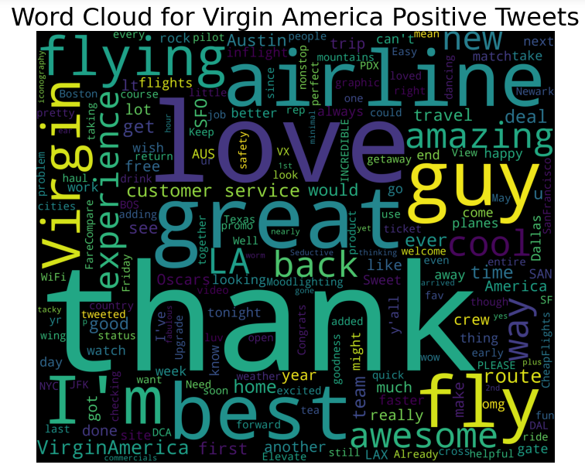
Threats
Notes:
Next

Slide 13
STRENGTHS
WEAKNESSES
Once customers are on the flight, they have few complaints about the experience, but in general positive comments are very generic
Booking systems are somewhat better than competitors
Complaints about baggage are an outsized issue for United – consider lowering baggage fees or finding other ways to improve the baggage experience
OPPORTUNITIES
THREATS
Complaints about delayed and cancelled flights plague all airlines – there is an opportunity for United to work to improve these metrics and stand above the competition
Other airlines have developed strong brand loyalty which helps customers see them more favorably. United is not a brand that people connect with.

Slide 14
Conclusions and Next Steps
Improve customer service
Review stats on late/cancelled flights, bag issues (could be specific to airport), etc to determine if there is an actual problem or a perception problem
Productionalize model for continued monitoring of issues

Slide 15
Thank you!

